Slide 1

Value Propositions for Car Insurance
September 2021
Author: REO
Notes:
.

Slide 2
Agenda
Why does a value proposition matter?
Competitor Analysis
Product Offerings
Strategies for Salience
Next steps

Slide 3
Why Value Propositions?

Slide 4
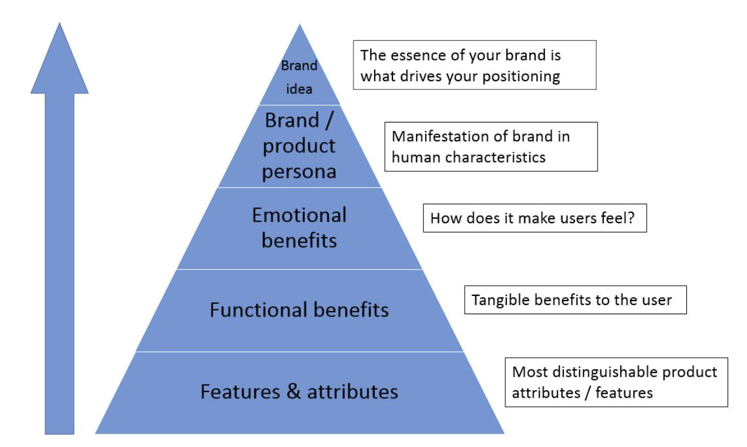
Why have a Value Proposition?
Customer Centric
Notes:
Data for the last 3 months

Slide 5
What are the benefits?
It tells the customer why they should buy from you rather than your competitors. It communicates a unique differentiation.
Improves customer understanding and engagement. This allows prospects to understand the value of your brand’s products and services.
Attracts the right kind of customer and increases the quantity but also the quality of prospects.
Competing solely on price is never a good idea as it becomes a commodity and margins will be minimized.
It allows brands to charge a premium as they become more trusted and valued.
Notes:
Data for the last 3 months

Slide 6
How specific does a Value Proposition need to be?
Macro Benefit:
Too abstract
Lots of “same-ness”
Becomes meaningless
The Space Between
Feature/function
Miss the “why”
Company centric, not customer centric
Notes:
Data for the last 3 months

Slide 7
Why have a Value Proposition
VALUE PROP
SALES PROP
CAMPAIGN PROP
“We make things easier for you”
MCDONALDS
“Convert More Traffic with Landing Pages”
UNBOUNCE
“Craft and small-batch drinks delivered to your office”
DESKBEERS
“Access to 1000’s of Gyms with no contract”
HUSSLE
“Car insurance that’s there when you need it”
AVIVA
“We deliver to you by partnering with Uber Eats”
MCDONALDS
“Create custom landing pages – no coding required”
UNBOUNCE
“Order by noon for next day delivery”
DESKBEERS
“Go once or as much as you like with our monthly pass”
HUSSLE
“We settled 98.8% of all motor insurance claims in 2020”
AVIVA
“Now your kids can get a Troll with every box!”
MCDONALDS
“20% off in our January Sale”
UNBOUNCE
“Free Fridge for Annual Subscriptions”
DESKBEERS
“50% off introductory offer”
HUSSLE
“Free legal assistance for one year”
AVIVA
Notes:
Data for the last 3 months

Slide 8
What are companies talking about?

Slide 9
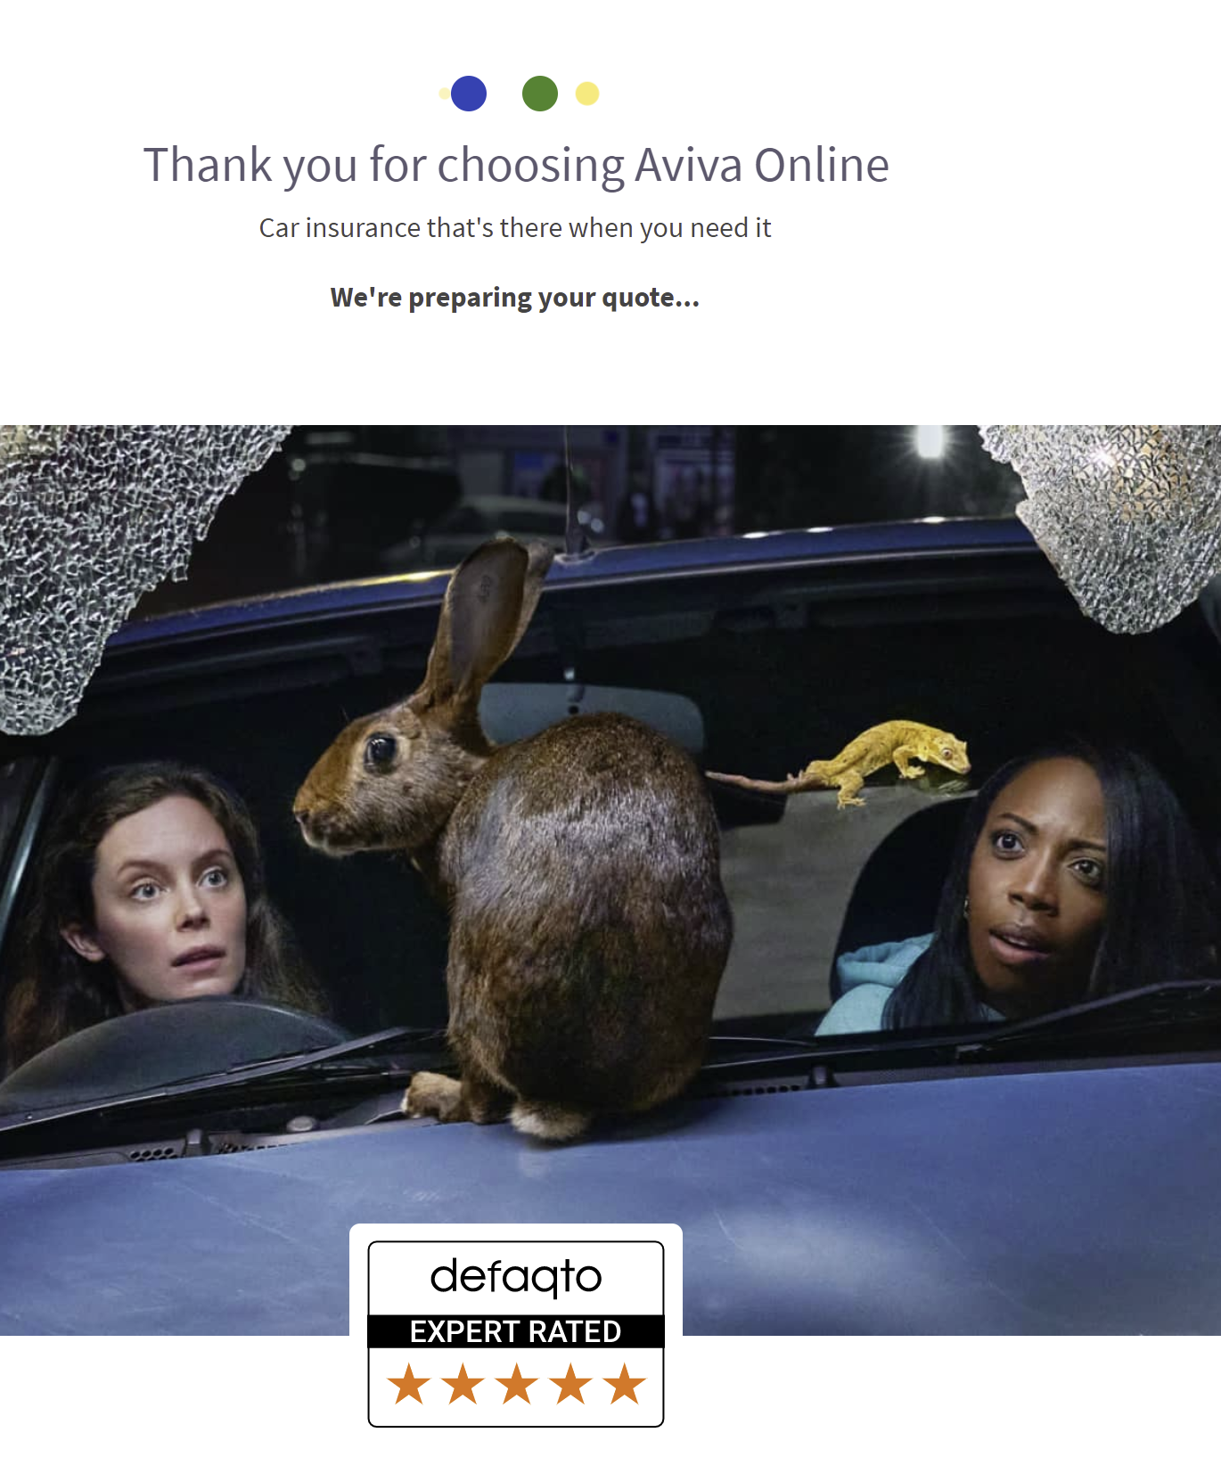
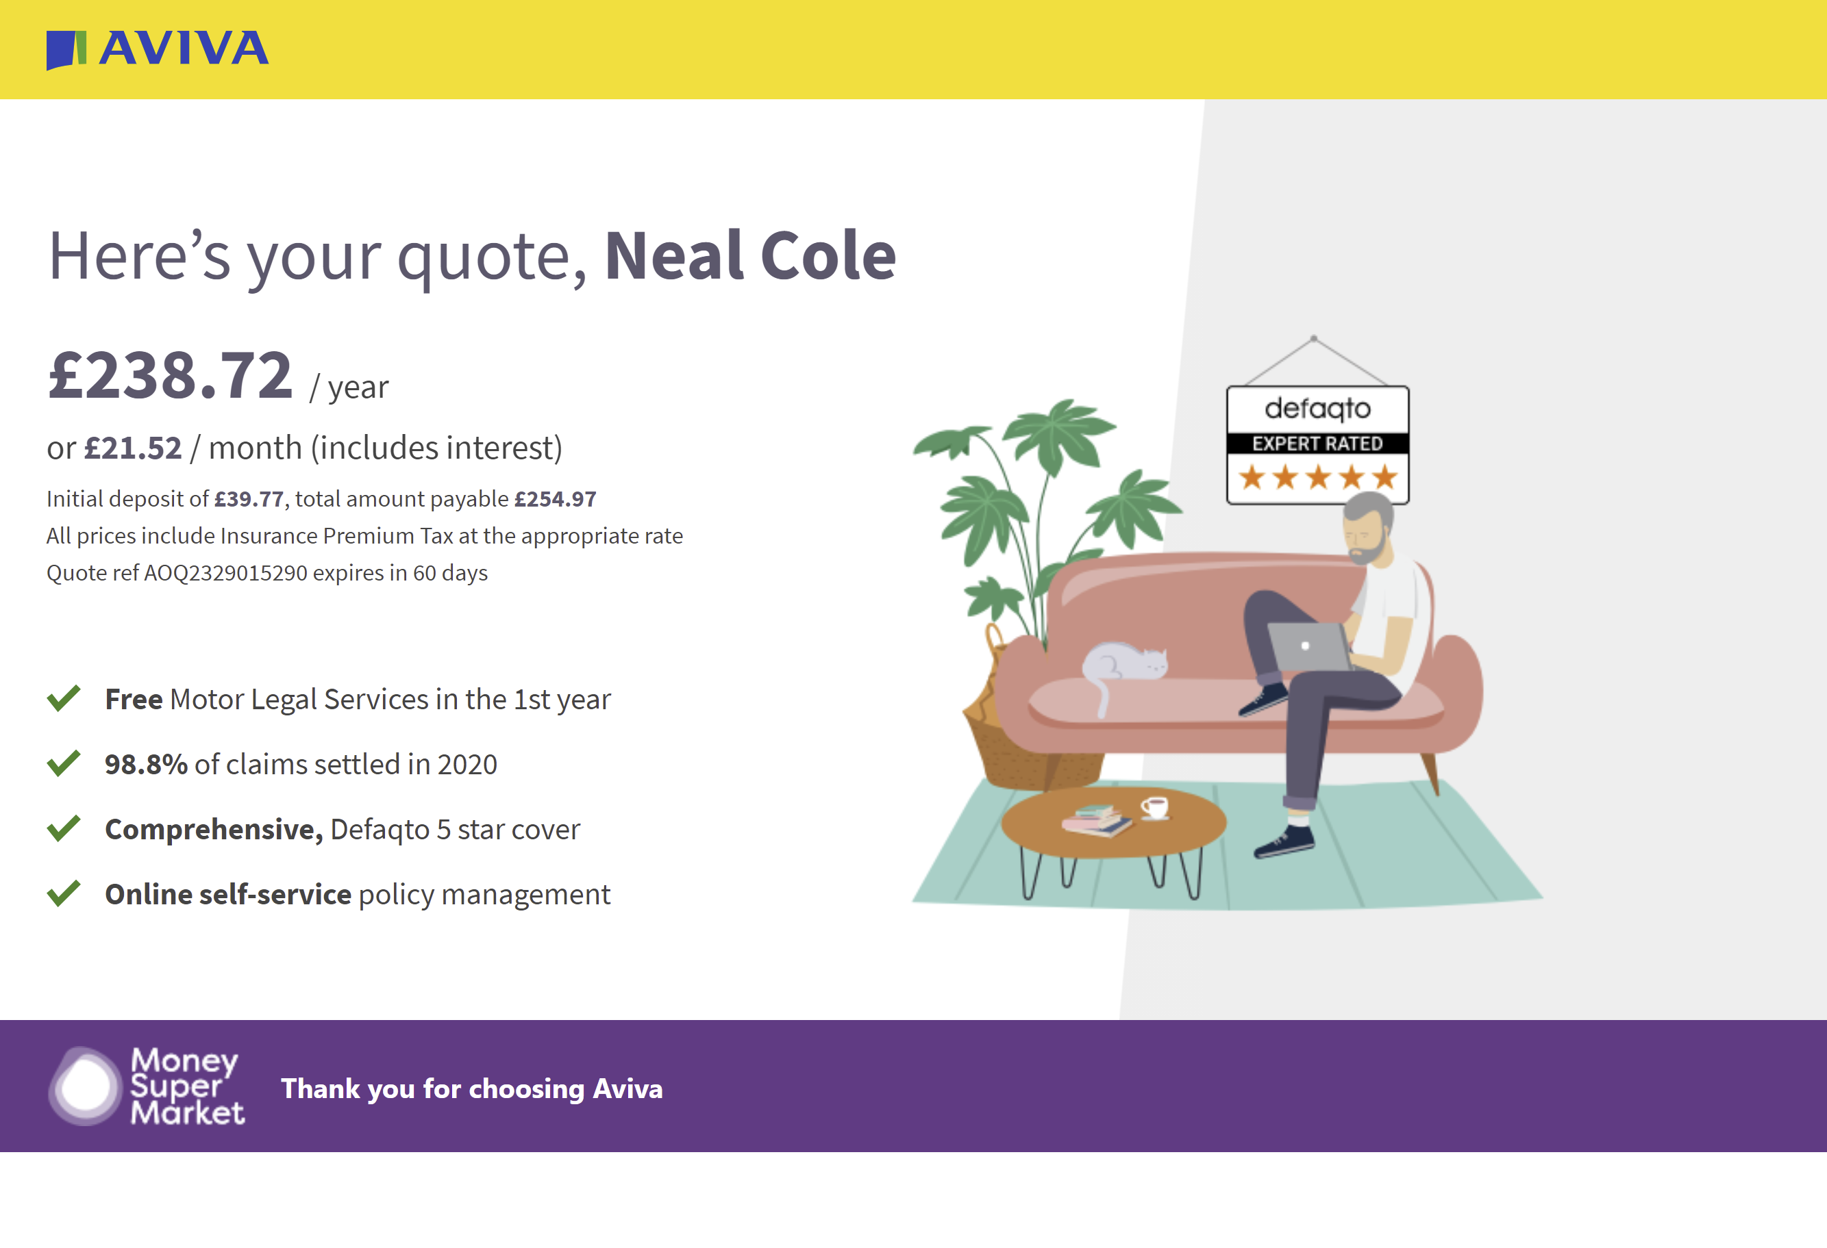

AVIVA – Value Proposition
Source: Copy,Copy,Copy – Mark Earls
Notes:
Data for the last 3 months

Slide 10
What about the rest?

Slide 11
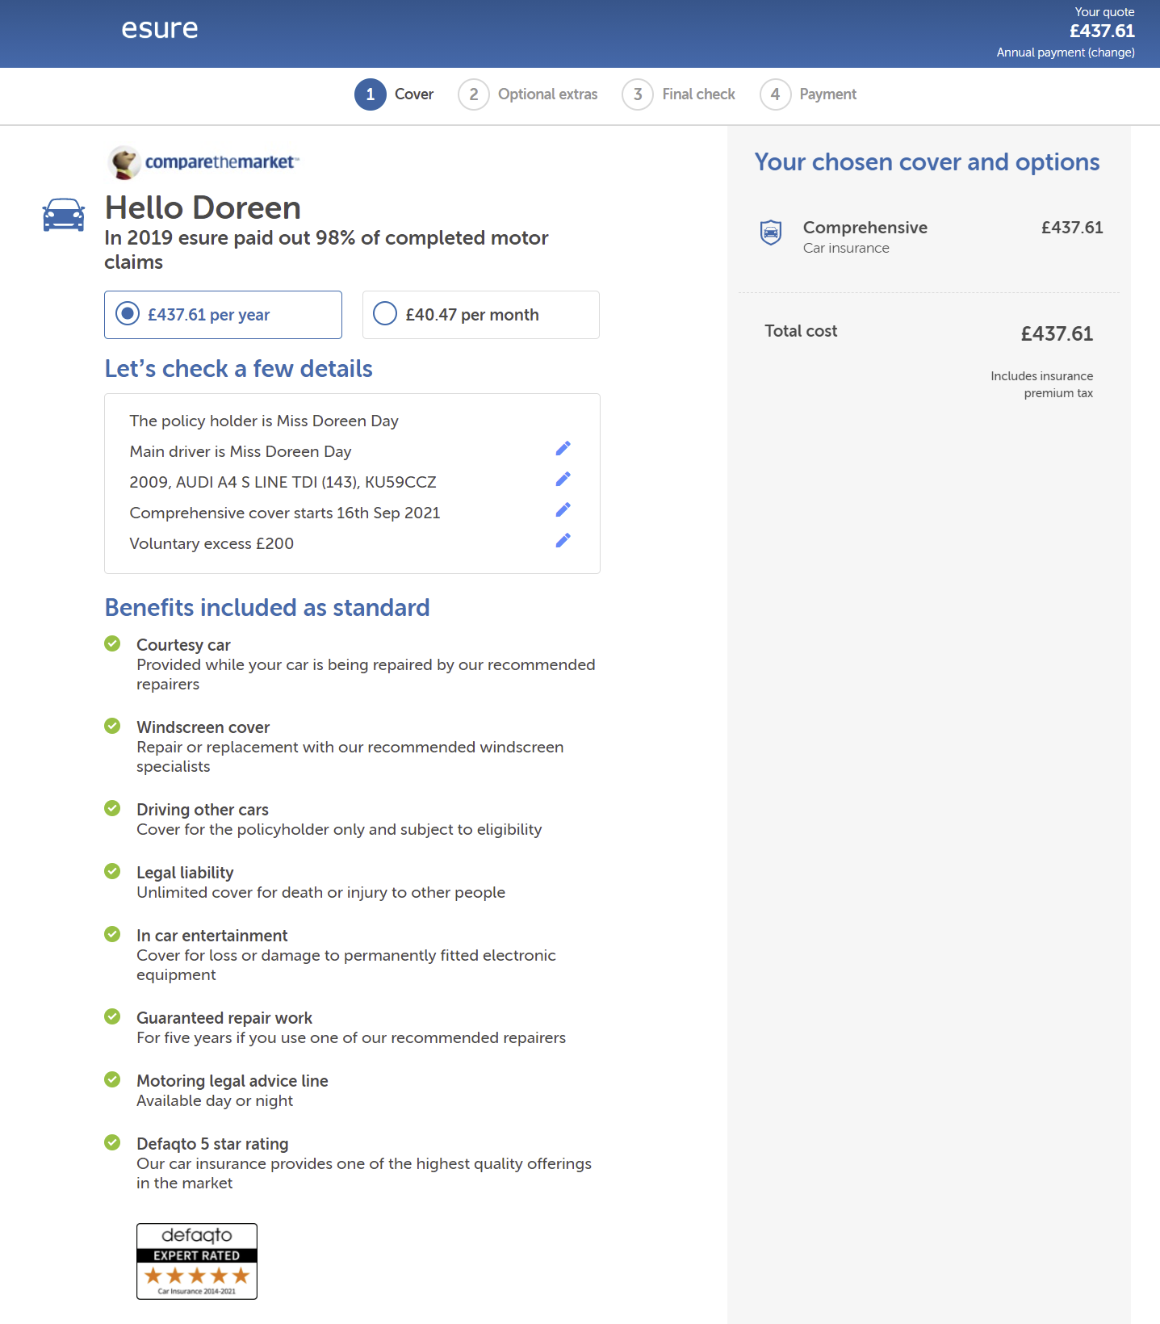
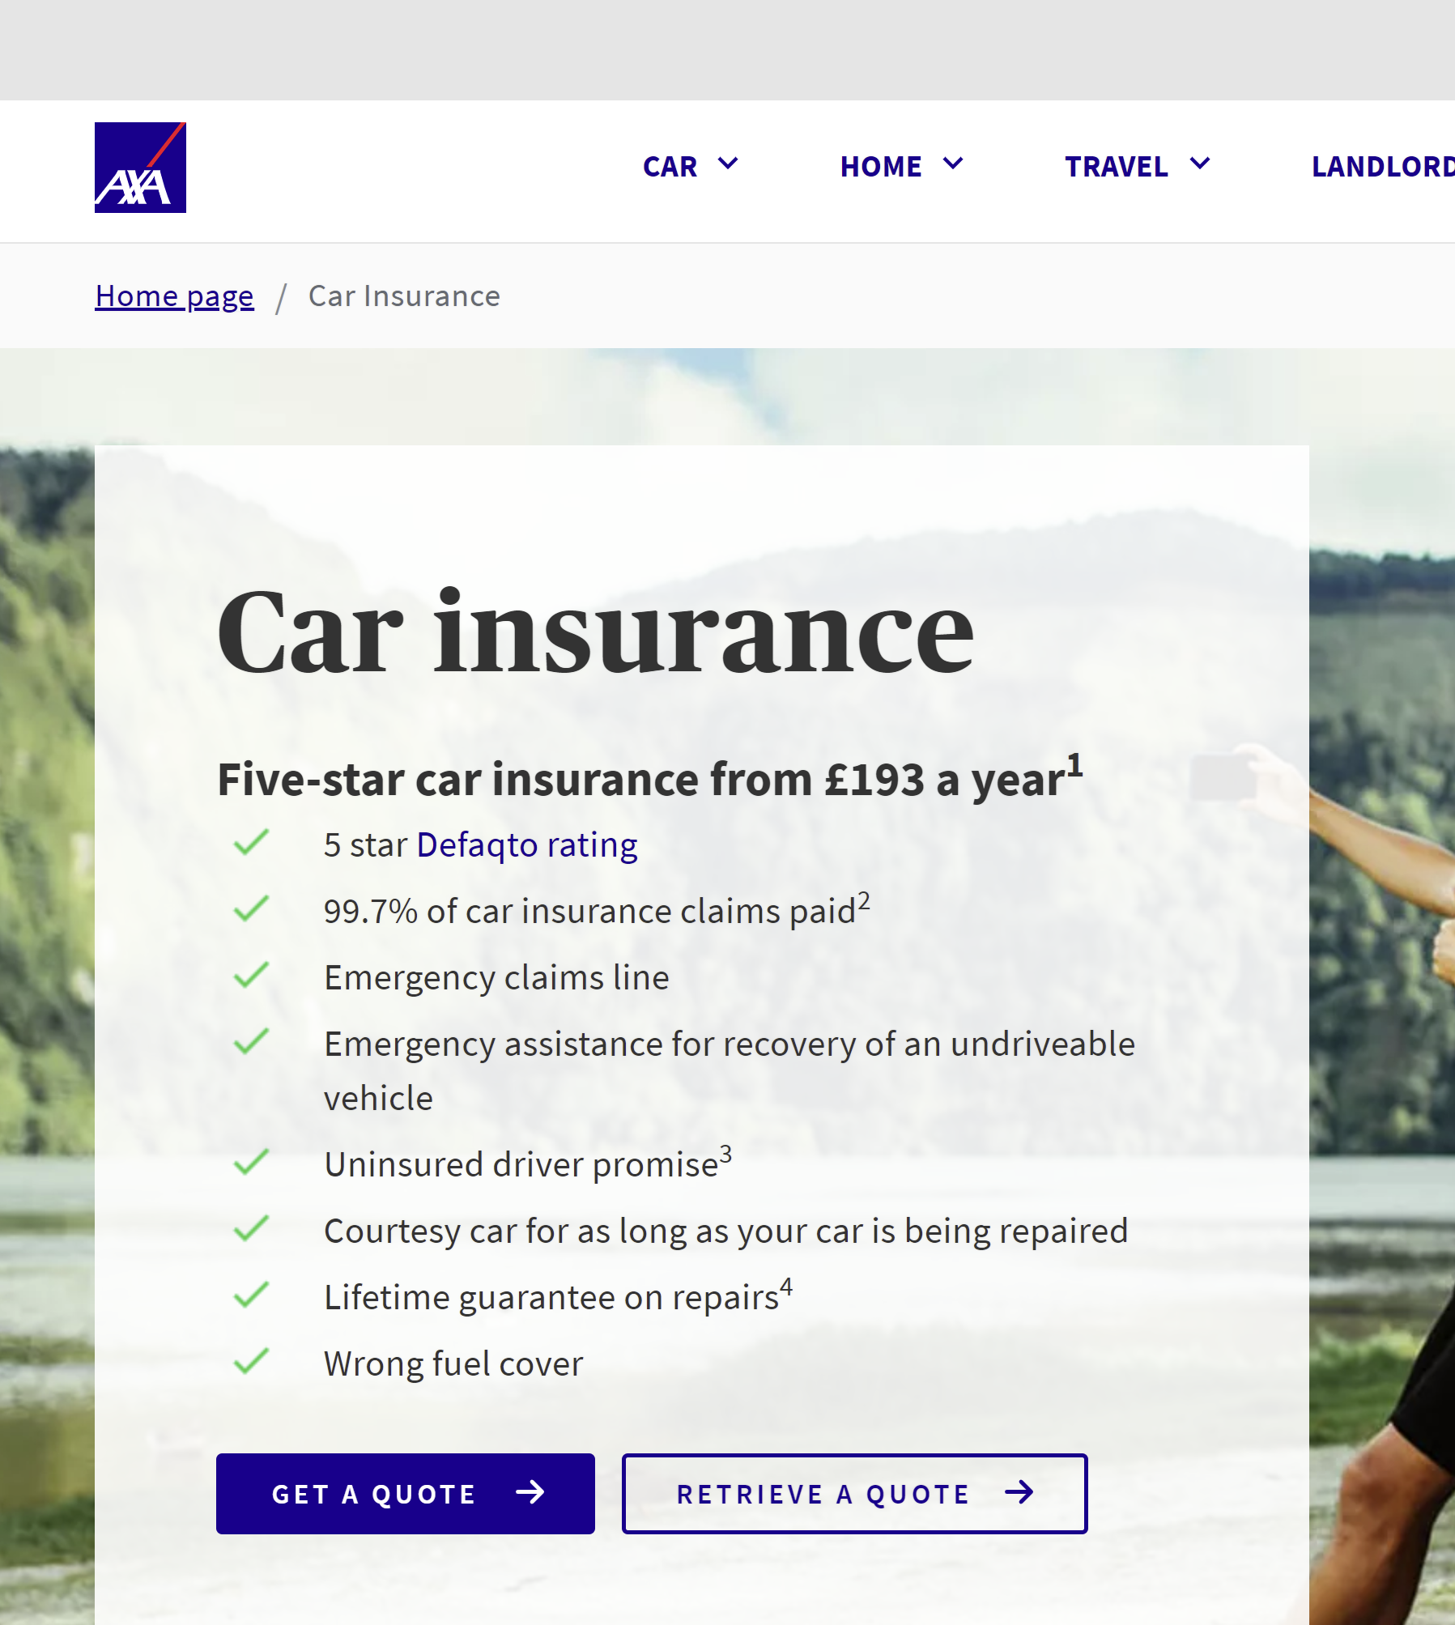
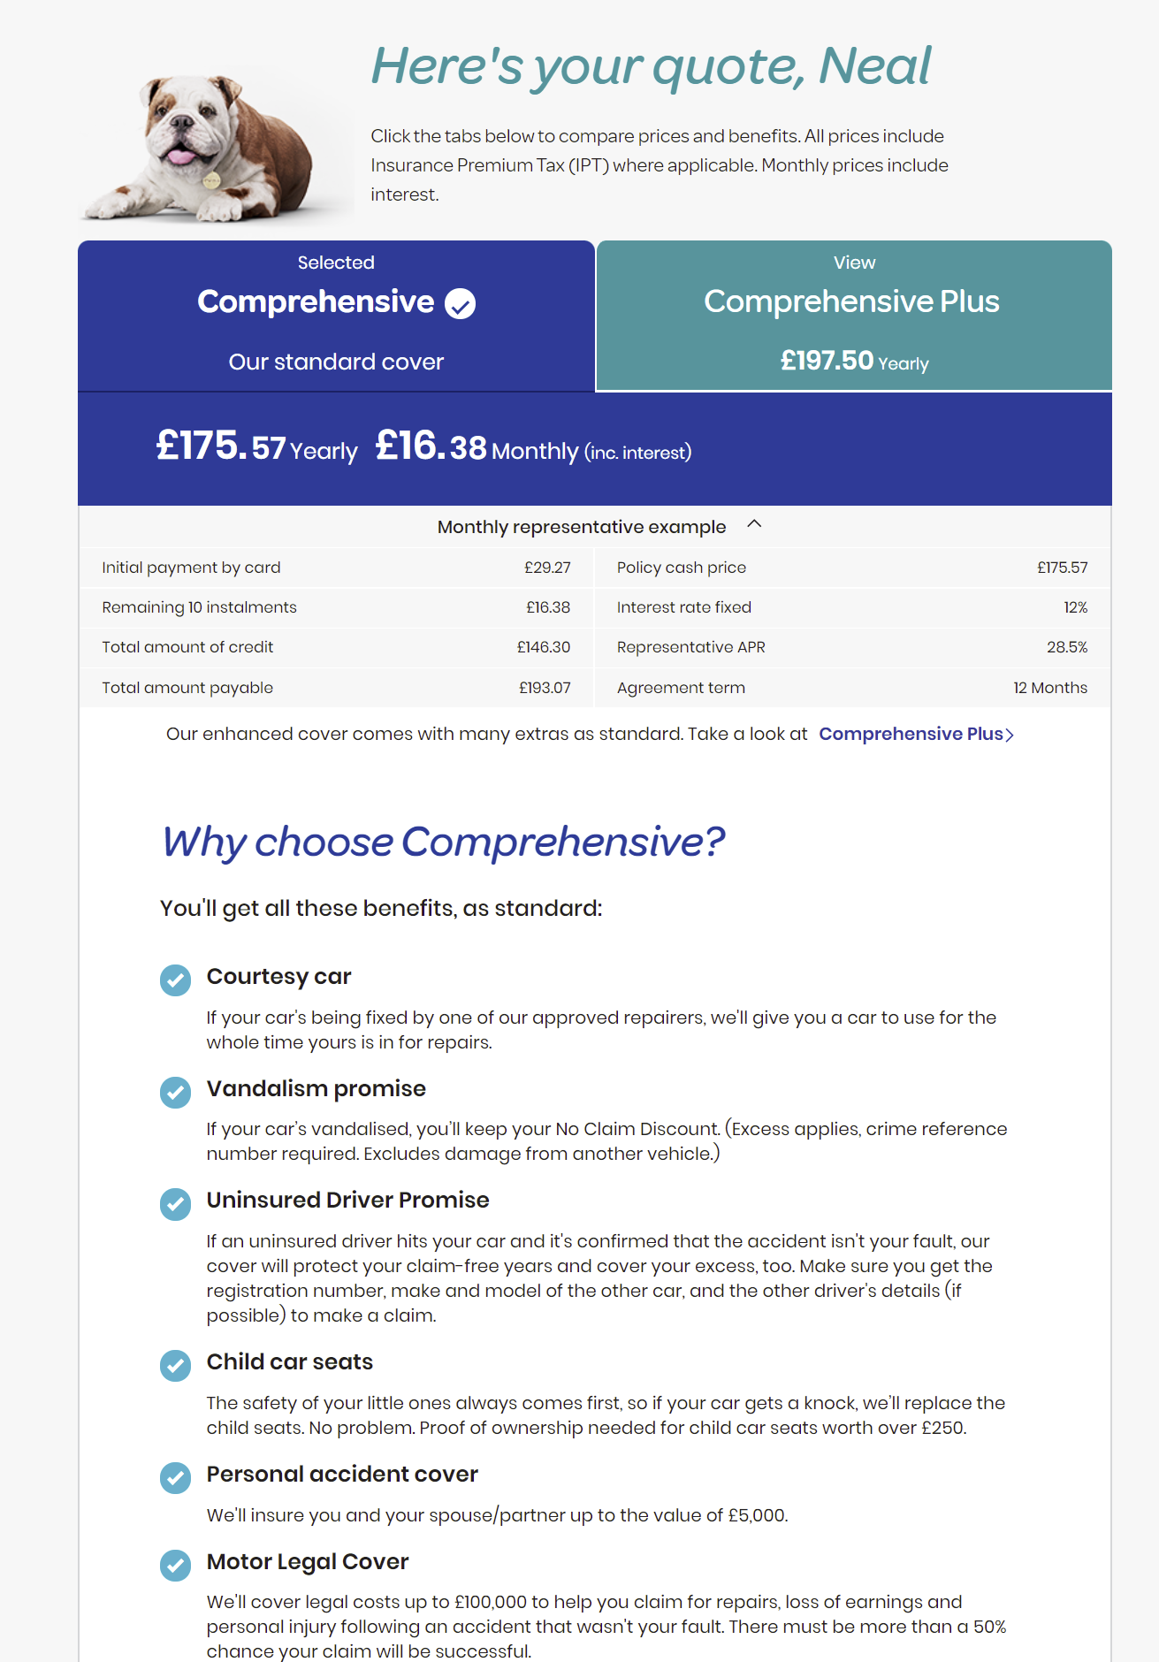
Slogans, benefits and features
Source: Copy,Copy,Copy – Mark Earls
Notes:
Data for the last 3 months

Slide 12


The League Table!
Feature or Benefits | Total out of 10 | esure offer?
Courtesy car | 10
Uninsured driver promise | 8
Windscreen cover | 7
Defaqto rating | 6
Driving other cars | 6
Limited European cover | 5
Personal accident cover | 5
Motoring legal advice line | 4
Personal belongings | 4
Percentage of claims paid | 3
Sound equipment | 3
Key cover | 3
Wrong fuel | 3
Car recovery & approved repair | 2
New vehicle replacement | 2
Guaranteed repair work | 2
MLP up to £100k | 1
Personal injury cover | 1
Accidental damage to car | 1
Vandalism promise | 1
Child car seat | 1
Notes:
Data for the last 3 months

Slide 13
How does esure compare?
Brand | % Claims Paid | Courtesy car | Windscreen Cover | Driving other cars | Sound equipment | Guaranteed repair work | Motor legal advice line | Defaqto rating
Esure
LV
Aviva
Admiral
Hastings
More Than
Churchill
AA
First Central
AXA
Total | 3 | 10 | 7 | 6 | 3 | 2 | 3 | 6
Notes:
Data for the last 3 months

Slide 14
Multiple Product Offerings

Slide 15
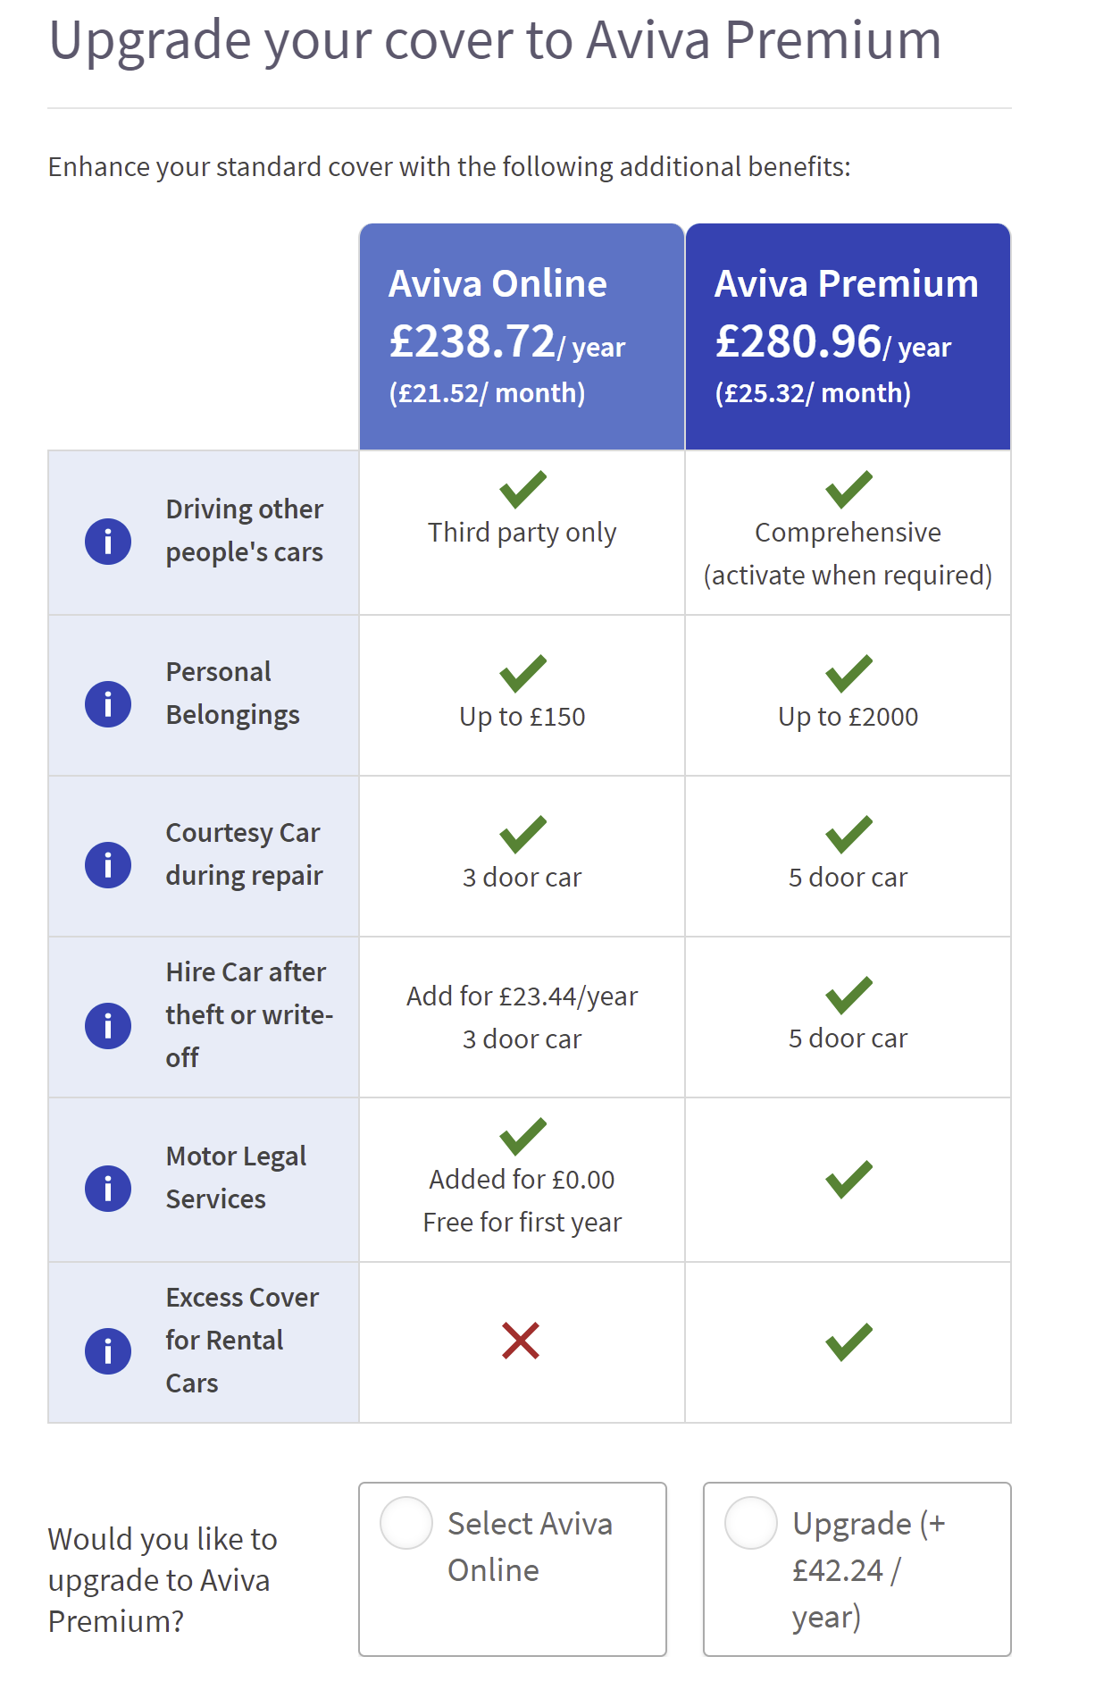
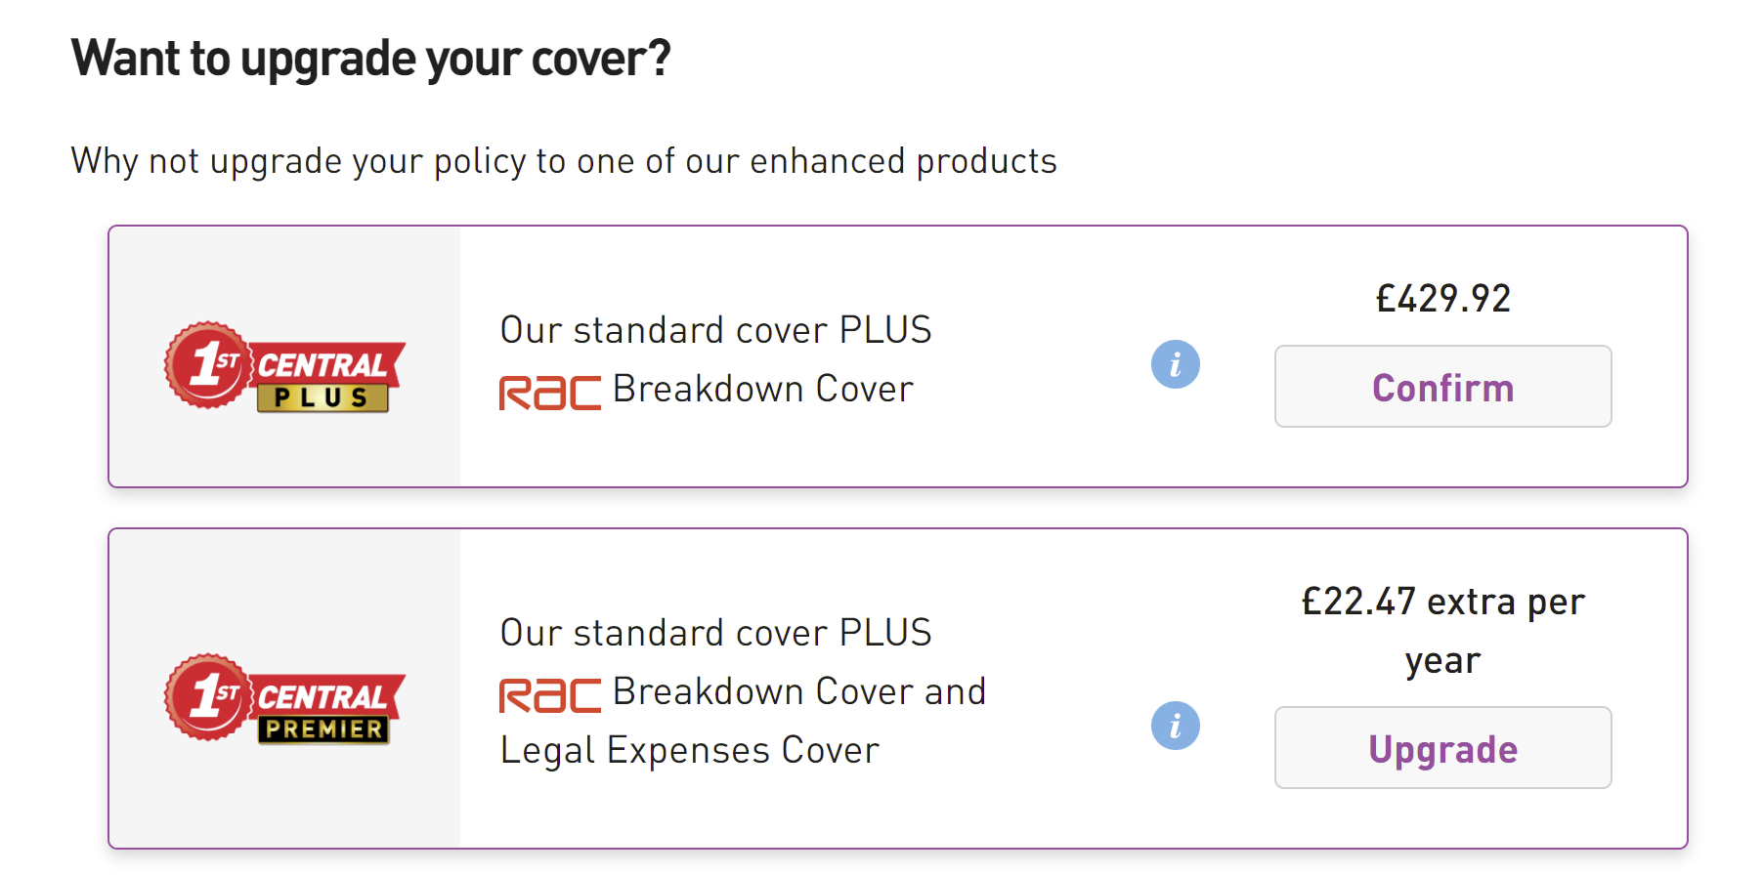
Differentiate by Product or Brand
Brand | 1 | 2 | 3 | 4
AVIVA | AVIVA Premium
Hastings Direct | Hastings Premier | People’s Choice
Churchill | Churchill Plus
LV | LV Plus
1st Central | 1st Central Premier | 1st Central Plus | 1st Central Value | 1st Central Legal
Swinton | Swinton Essentials | Swinton Classic
Notes:
Data for the last 3 months

Slide 16
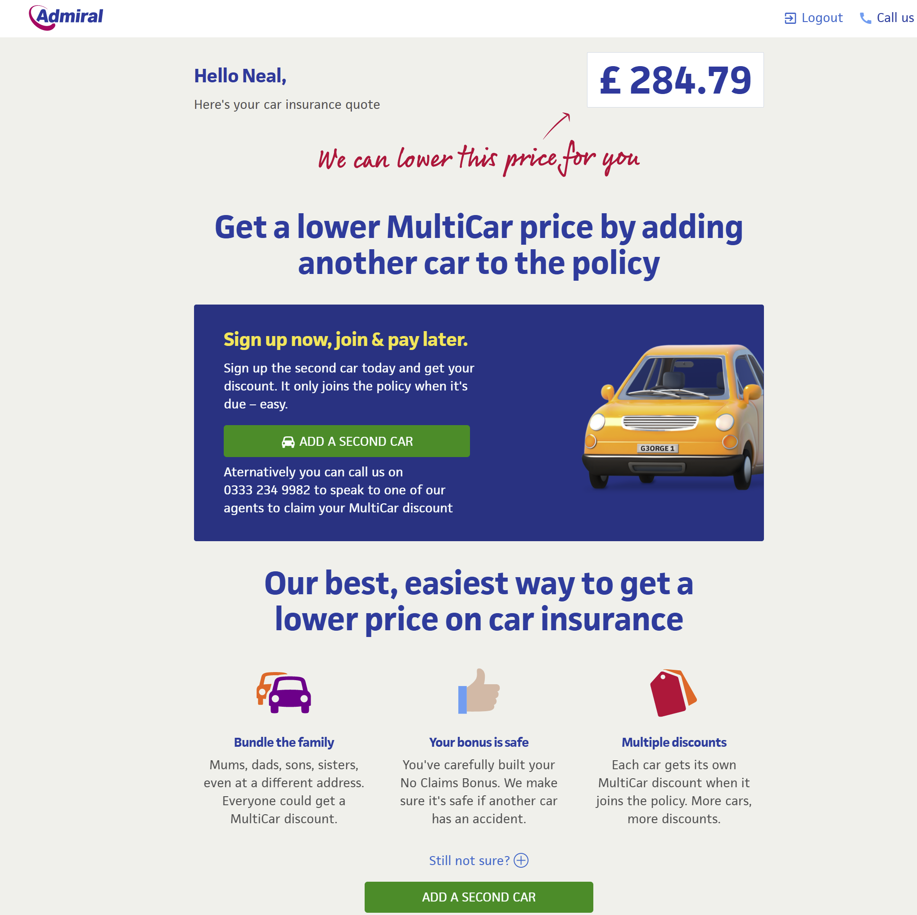
Admiral - MultiCar
Notes:
Data for the last 3 months

Slide 17
Other Strategies for Salience

Slide 18
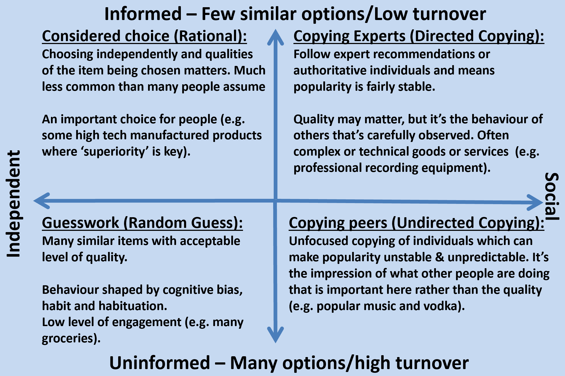
What is the most common decision style?
Source: Copy,Copy,Copy – Mark Earls
Notes:
Data for the last 3 months

Slide 19
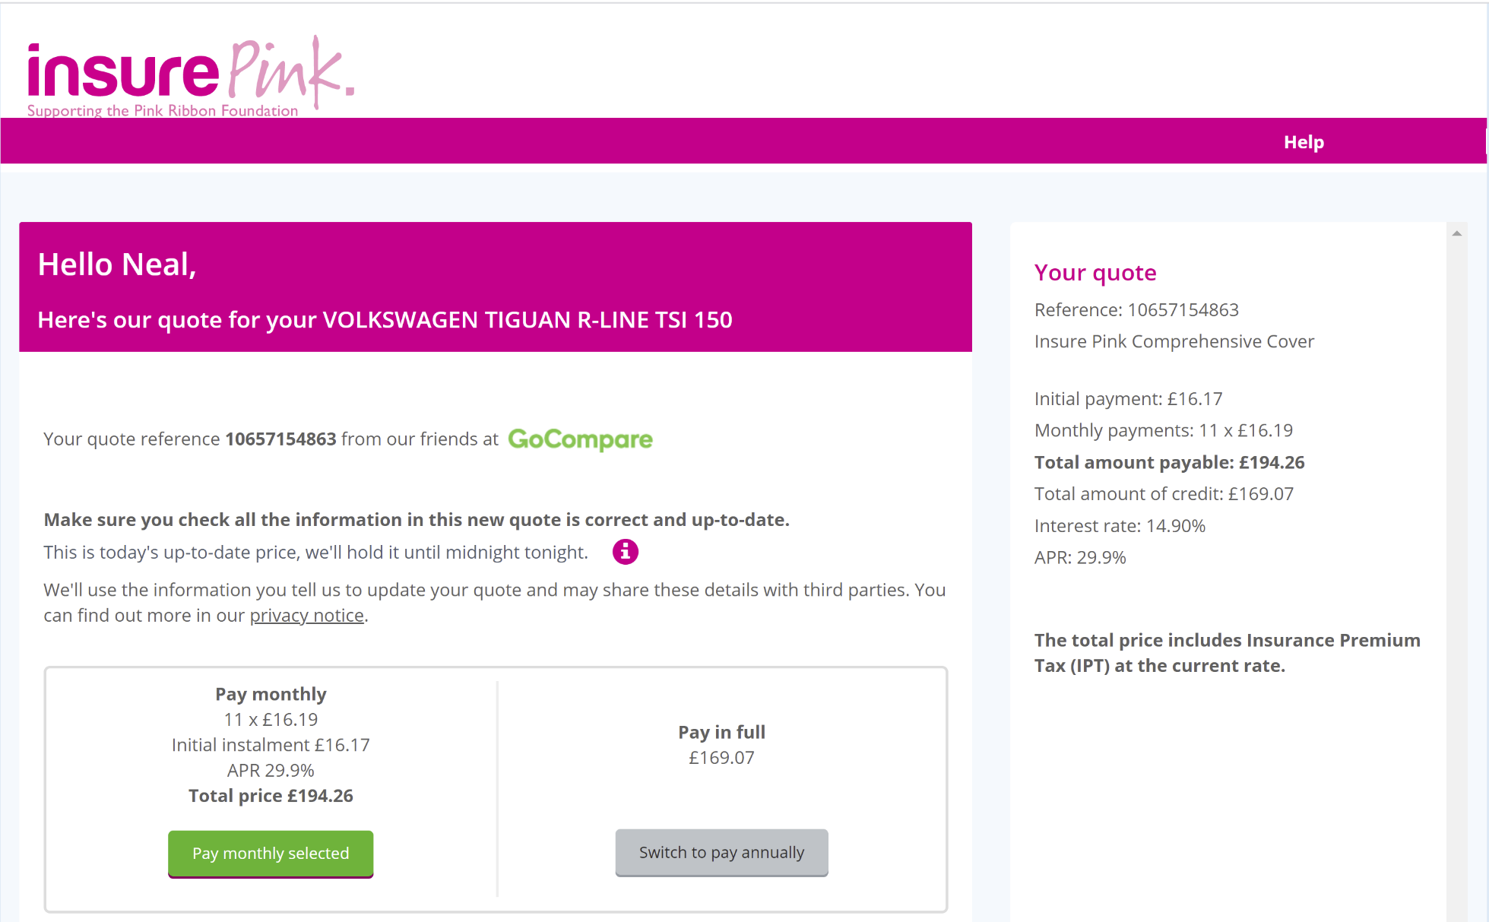
Collaborate with non-competitive brands
Notes:
Data for the last 3 months

Slide 20
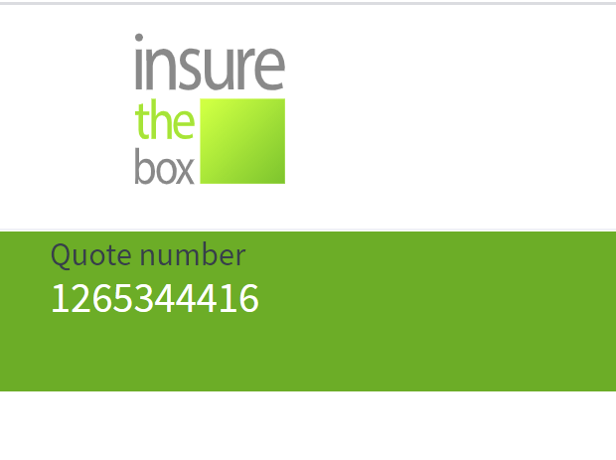
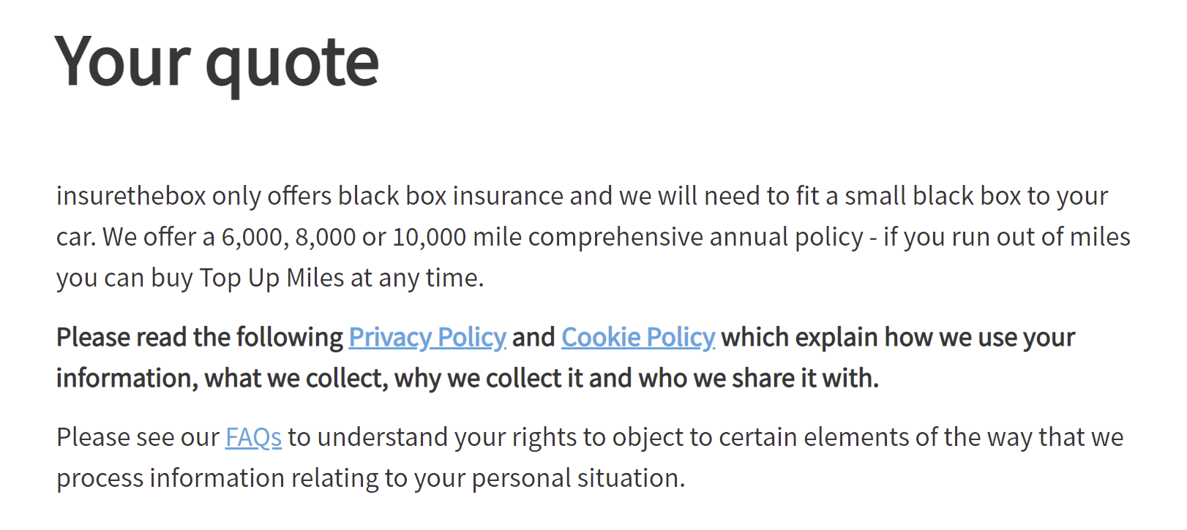
Make it hard to leave
Notes:
Data for the last 3 months

Slide 21
Other Marketing Strategies for Salience (1):
Seek fame at all costs.
Go Compare use humour and opera singer to get attention.
.
2. Shout louder.
Compare The Market use this strategy.
Make it easier to choose you!
Availability is an important cognitive factor in shaping buyer behaviour. Trying to become the default option is a powerful strategy as people are lazy and will often go for the path of least resistance.
Source: Copy,Copy,Copy – Mark Earls
Notes:
Data for the last 3 months

Slide 22
Marketing Strategies for Salience (2):
Reward those who have chosen you before.
Loyalty cards, loyalty discounts and random acts of kindness (RAOK’s) such as birthday cards or gifts.
5. Make it harder to choose anyone else.
Ubiquity also means effective exclusivity. Buying distribution through partnerships with other brands involved in the delivery of your product can be a highly effective strategy to gain market share over competitor brands.
6. Use aggressive price points to drive choice.
Aggressive cost cutting is a common strategy to cut through but is expensive to maintain and reduces margins
Source: Copy,Copy,Copy – Mark Earls
Notes:
Data for the last 3 months

Slide 23
Marketing Strategies for Salience (3):
7. Eye watering discounts and events.
Heavy discounting and discount based events can help drive short-term sales. This can include traditional promotions as well as events such as Black Friday and Cyber Monday.
8. Promote an unusual and irrelevant feature.
The main stream beer market has been prone to this as Boddingtons promoted a widget in the can to recreate the qualities of draught beer.
9. Highlight cost of delay.
Get people to focus on the financial penalties of delay as people are loss averse and don’t like to feel regret if they miss out on a limited offer. Scarcity also makes something appear to be more valuable than if there is no restriction on its availability. Those endless furniture sales that ‘must end Monday’ or the money you can save on a holiday, but only if you act now.
Source: Copy,Copy,Copy – Mark Earls
Notes:
Data for the last 3 months

Slide 24
Next Steps
New brand purpose should inform the development of brand value proposition.
A/B testing to inform the process by measuring engagement with different proposed value propositions.
A/B test can validate different treatments of value propositions using imagery, tag lines, copy, tone of voice and campaign offers.
Notes:
Data for the last 3 months

